Slide 1
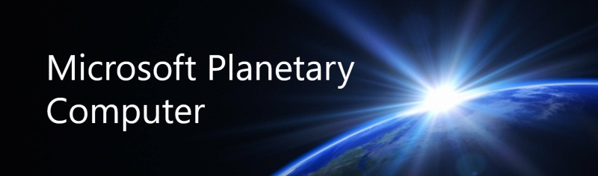

Slide 2
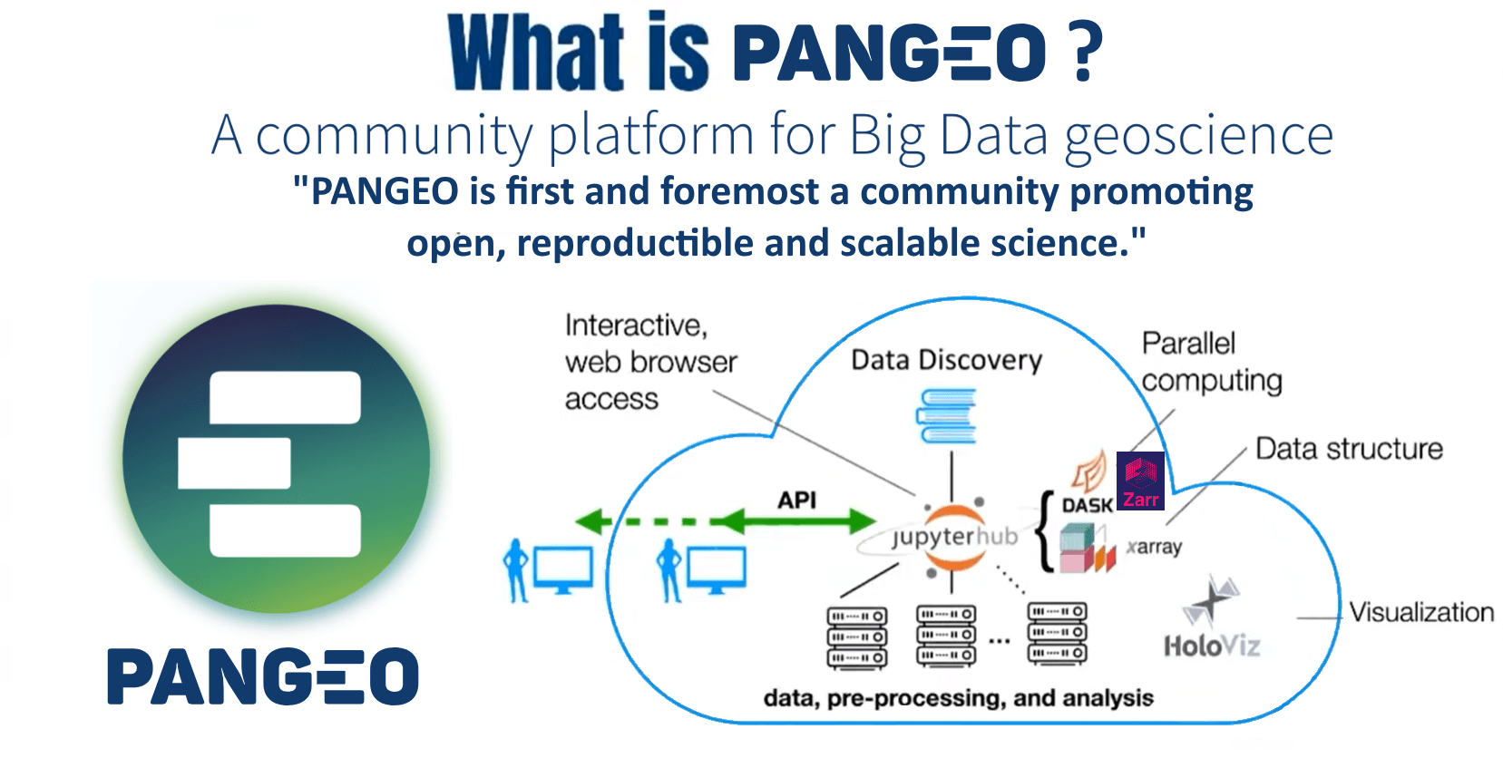
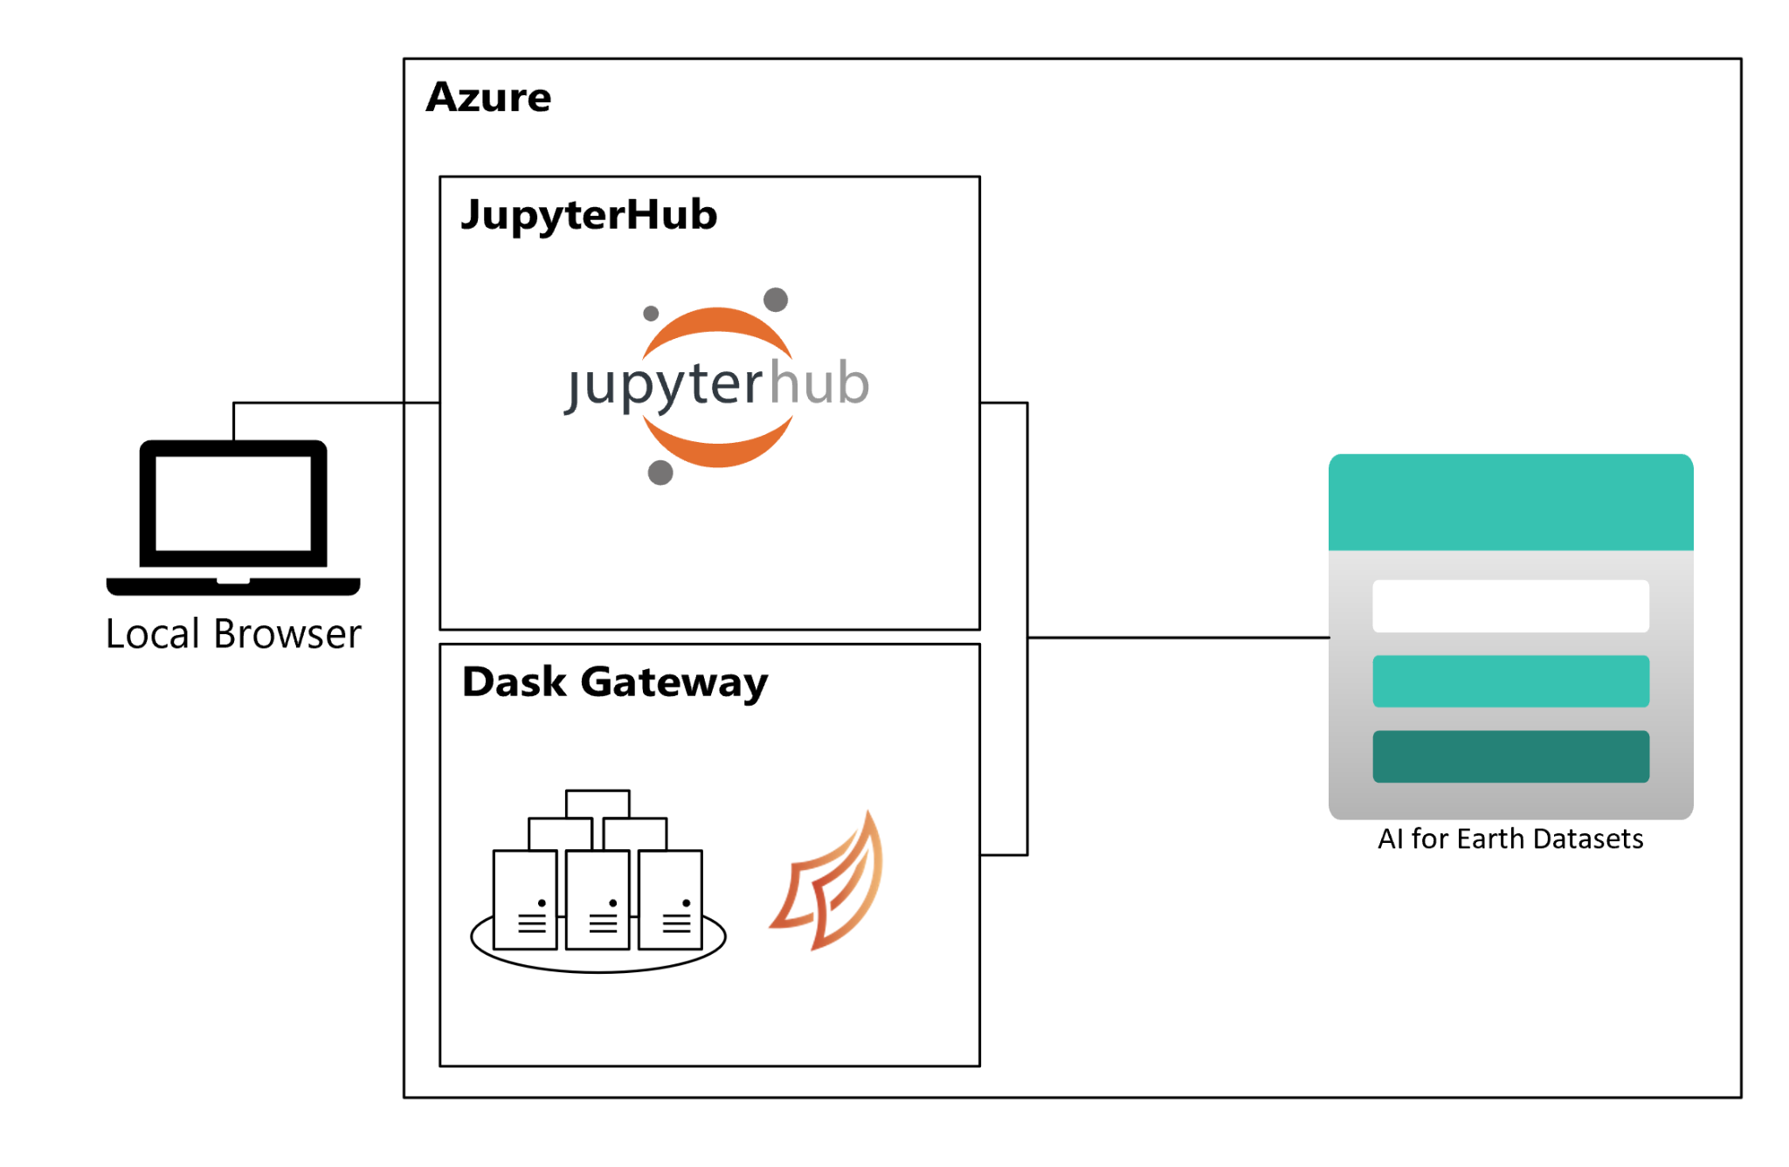
Planetary Computer: What is it ?

Slide 3

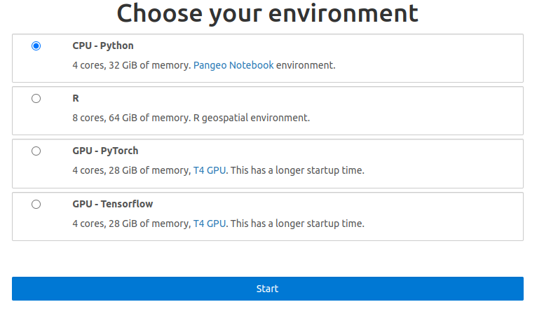
https://pccompute.westeurope.cloudapp.azure.com/compute/hub/spawn
The Planetary Computer Hub is a development environment that makes our data and APIs accessible through familiar, open-source tools, and allows users to easily scale their analyses with the power of Azure compute.

Slide 4
Ressources
https://github.com/microsoft/PlanetaryComputerExamples

